Slide 1
SSL/TLS and HTTPs
Secure Socket Layer, Transport Layer Security, Secure HTTP, Function Libraries for Encrypting Traffic
Online Material

Slide 2
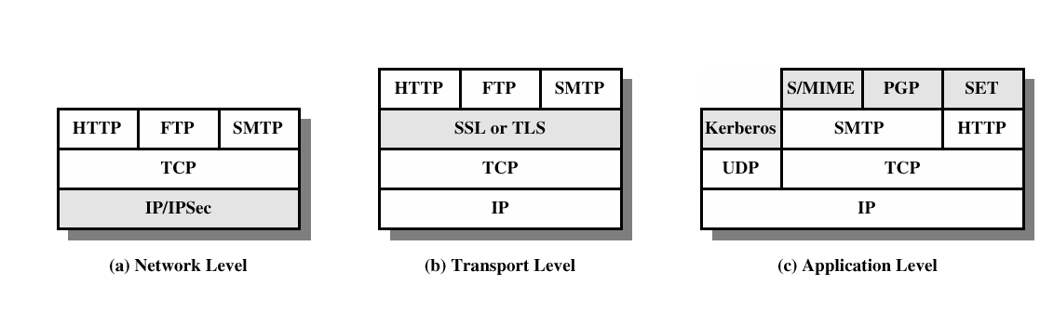
Security facilities in the TCP/IP stack
Pretty Good Privacy (PGP):
a data encryption and decryption computer program
provides cryptographic privacy and authentication for data communication.
used for signing, encrypting and decrypting e-mails

Slide 3
Security facilities in the TCP/IP stack
S/MIME (Secure/Multipurpose Internet Mail Extensions)
a standard for public key encryption and signing of MIME data.
provides the following cryptographic security services:
authentication
message integrity
non-repudiation of origin (using digital signatures)
privacy
data security (using encryption)
Kerberos (the hound of Hades ):
computer network authentication protocol
allows nodes communicating over a non-secure network to prove their identity to one another in a secure manner.
provides mutual authentication — both the user and the server verify each other's identity.

Slide 4
SSL and TLS
SSL was originated by Netscape
TLS working group was formed within IETF
First version of TLS can be viewed as an SSLv3.1
SSL
SSL Architecture
SSL Record Protocol
Change Cipher Spec Protocol
Alert Protocol
Handshake Protocol

Slide 5
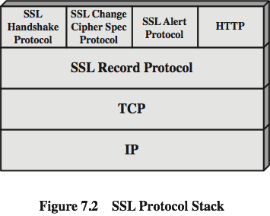
SSL architecture
Not a single protocol
two layers of protocols
Provides basic security services to higher layer protocols
e.g. HTTP operates on top of SSL
Three higher layer protocols are part of SSL

Slide 6
SSL session / SSL connection
Two important concepts : SSL connection and SSL session
SSL connection
Transport that provides a suitable type of service
An SSL connection is peer-to-peer relationship (transient)
Every SSL connection is associated with one session
SSL session
Association between a client and a server
Created by the Handshake Protocol
Define a set of cryptographic security parameters
States :
Session Established : Current operating state for receive and send
Handshake Protocol: Pending State for receive and send
If handshake successful, pending state becomes current operating state

Slide 7
SSL record protocol: Services
Two services for SSL Connections
Confidentiality
Defines a shared secret key that is used for conventional encryption
Message Integrity
Defines a shared secret key that is used to form a message authentication code (MAC)
Compression
Lossless compression to shrink the message size
Default compression algorithm defined as NULL in SSLv3 and current version of TLS

Slide 8
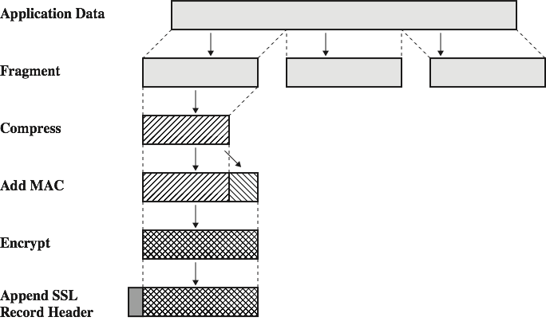
SSL record protocol: Operation
No distinction is made among various applications using SSL; the content of data is opaque to SSL
Fragment: 2¹⁴ bytes
Compression: Optional
Message Authentication Code: shared secret key is used to compute MAC
Encryption: Symmetric

Slide 9
SSL record protocol: Operation
First Step Fragmentation: Each upper layer message is fragmented into block of 2¹⁴ bytes (16384 bytes) or less
Second Step Compression: Optional step, must be lossless and may not increase the length by more than 1024 bytes
Third Step Message Authentication Code (MAC): shared secret key is used to compute MAC
Fourth Step Encryption: compressed message (if applied) and MAC are encrypted using symmetric encryption
Final Step Header Preparation.

Slide 10
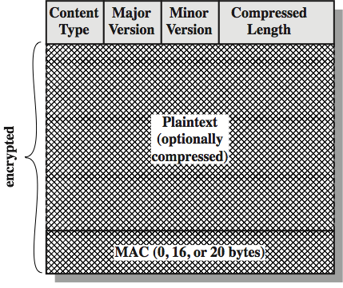
SSL record format
Content Type (8 bits)
Higher layer protocol used to process the enclosed fragment such as change_cipher_spec, alert, handshake and application data
Major Version (8 bits)
Major Version of SSL e.g. For SSL v3 = 3
Minor Version (8 bits)
Minor Version of SSL e.g. For SSL v3 = 0
Compressed Length (16 bits)
The length in bytes of plaintext or compressed fragment

Slide 11
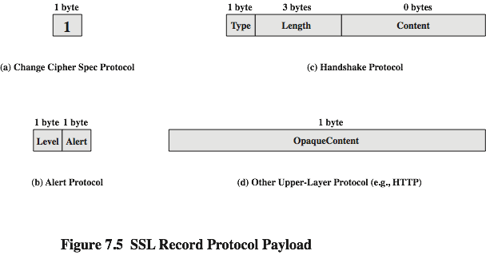
SSL change cipher spec protocol
Uses SSL Record Protocol
Simplest one : Consists of a single message, which consists of single byte with value 1
Purpose is to convert pending state into current state

Slide 12
Alert protocol
Conveys SSL-related alerts to peer
Compressed and Encrypted
Consists of two bytes
The first byte indicates Alert Level (indicates severity)
Warning
Fatal
Will immediately terminate the connection
Alerts that always will be fatal
unexpected_message, bad_record_mac, decompression_failure, handshake_failure, illegal_parameter
The second bytes indicates the specific alert
Warning alerts
close_notify, no_certificate, bad_certificate, unsupported_certificate, certificate_revoked, certificate_expired, certificate_unknown

Slide 13
Handshake protocol
The most complex part of SSL.
Server and client authenticate each other.
Server and client negotiate encryption, MAC algorithm and cryptographic keys.
Used before any application data is transmitted.
Message Format
Type: Indicate one of ten messages (e.g. Hello, certificate, key exchange)
Length: The length of message
Content: The parameters associated with this message

Slide 14
Handshake protocol: Phases
Phase 1: Establish Security Capabilities
Initiate logical connection and establish security capabilities to be associated with it.
Phase 2: Server Authentication and Key Exchange
Sends a certificate (if authentication is required)
May send Server_Key_Exchange message
Phase 3: Client Authentication and Key Exchange
Client verifies certificate from server and server_hello parameters
May send a certificate (on request) or alert for no certificate or one or more message
Phase 4: Finish
Completes secure connection

Slide 15
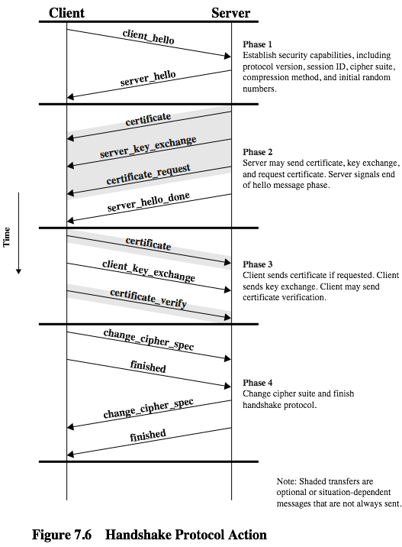
Handshake protocol in action

Slide 16
Transport Layer Security (TLS)
The same record format as the SSL record format.
Defined in RFC 5246.
Similar to SSLv3.
Differences in the:
version number : major version 3, minor version 3 (TLS v1.2)
message authentication code (RFC 2104 HMAC)
pseudo random function
alert codes (same as SSLv3 except no_certificate)
cipher suites : no longer support for Fortezza
client certificate types
certificate_verify and finished message
cryptographic computations
padding

Slide 17
HTTPS
HTTP over SSL : combination of HTTP and SSL
RFC 2818 : HTTP Over TLS , no fundamental change in HTTP over SSL or TLS
Secure communication between Web browser and Web servers
Built into all modern Web browser
Web servers should support HTTPS communications
Connection Initiation
Client initiates a connection to server on appropriate port (default: 443)
SSL/TLS handshake is performed
Data is sent
Connection Closure
Client indicate closing of connection, Connection : close
Client must be able to cope with a situation, if a connection is terminated without close notification and issue security warning

Slide 18
APIs
Libcrypto
OpenSSL / LibreSSL
mbed TLS
Libcurl

Slide 19
OpenSSL
Open Source toolkit implementing SSL v2/v3 and TLS protocols as well as a full-strength general-purpose cryptography library

Slide 20
LibreSSL
LibreSSL is a version of the TLS/crypto stack forked from OpenSSL in 2014, with goals of modernizing the codebase, improving security, and applying best practice development processes.
More secure?

Slide 21
mbed TLS
Former PolarSSL
Acquired by ARM and rebranded mbed TLS
Direct replacement for OpenSSL from a standard point of view
Different API
Better documentation and code structure
More intuitive API
More secure?

Slide 22
Libcurl
Highly portable and easy-to-use client-side URL transfer library
Supports: DICT, FILE, FTP, FTPS, GOPHER, HTTP, HTTPS, IMAP, IMAPS, LDAP, LDAPS, POP3, POP3S, RTMP, RTSP, SCP, SFTP, SMTP, SMTPS, TELNET and TFTP.
libcurl also supports HTTPS certificates, HTTP POST, HTTP PUT, FTP uploading, kerberos, HTTP form-based upload, proxies, cookies, user+password authentication, file transfer resume, http proxy tunneling and more!

Slide 23
Client-server setup
Server
Client

Slide 24
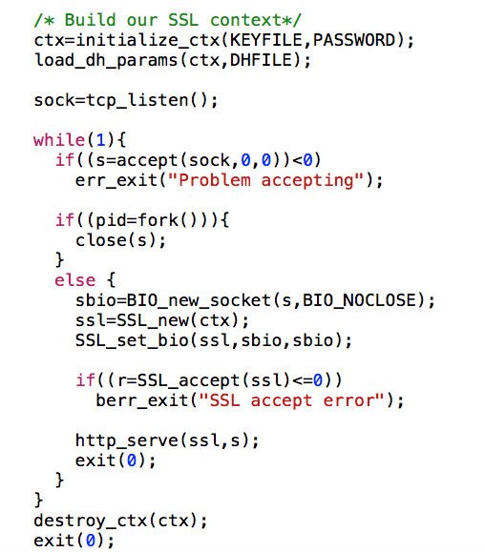
Server main()

Slide 25
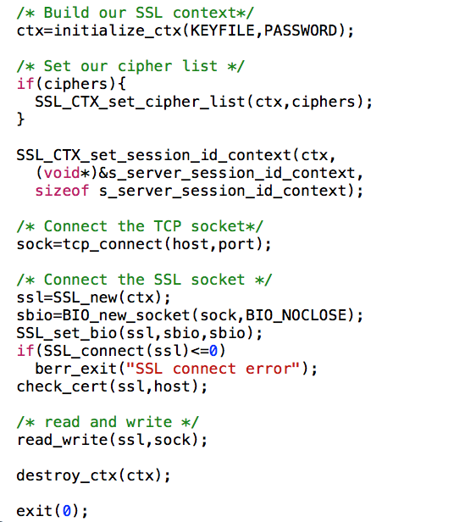
Client main()

Slide 26
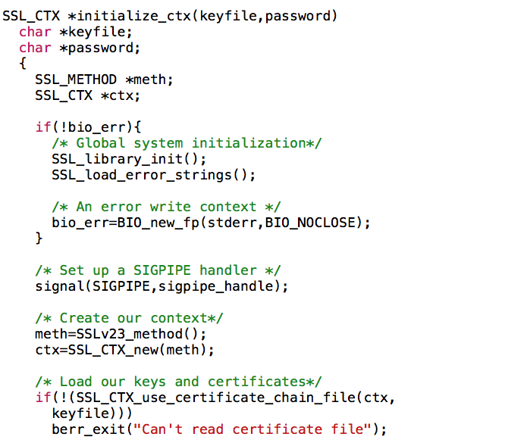
Common code

Slide 27
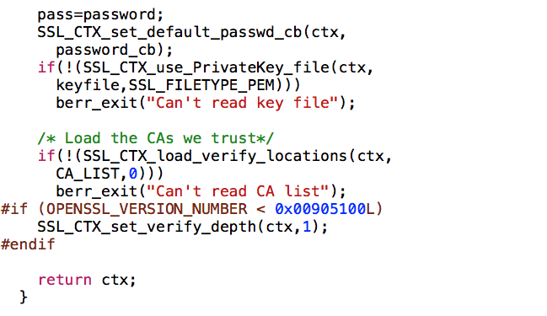
Common code (cont.)

Slide 28
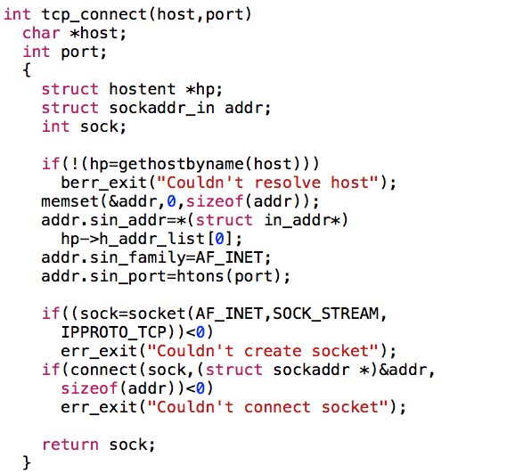
Client tcp_connect()

Slide 29
Server accept()

Slide 30
Read/write
SSL_read(const SSL *ssl, void *buf, int num)
Similar to read(), ssl is the SSL “file descriptor"
Returns number of bytes read
SSL_write(SSL *ssl, const void *buf, int num)
Similar to write(), ssl is the SSL “file descriptor”
Returns number of bytes written
SSL_get_error(const SSL *ssl, int ret) should be used to test the return values (passed in ret)
Returns SSL_ERROR_NONE if read/write was succesfull

Slide 31
Terminate connection
SSL_shutdown(SSL *ssl) is used to shut down an active SSL/TLS connection
SSL_free() decrements the reference count of ssl
If count reaches zero, the memory is freed
Don’t forget to close the socket as well!

